Slide 1
Expressional Response to Ammonium and Nitrate in Salicornia depressa
Marsh Eutrophication
Presented by Jeny Sherchan, Sean Hernon, and Jayna Fawcett

Slide 2
Background
Eutrophication can occur in salt marshes
Overabundance of nitrogen alters plant growth
The type of nitrogen matters
Ammonium (NH₄⁺) -> longer roots; comes from fertilizer runoff
Nitrate (NO₃⁻) -> lateral growth; comes from tidal waters
Salicornia depressa contacts tidal water twice a day and
runoff water when it rains
Notes:
Johnson et al.
If invest energy in roots, less energy for reproduction

Slide 3
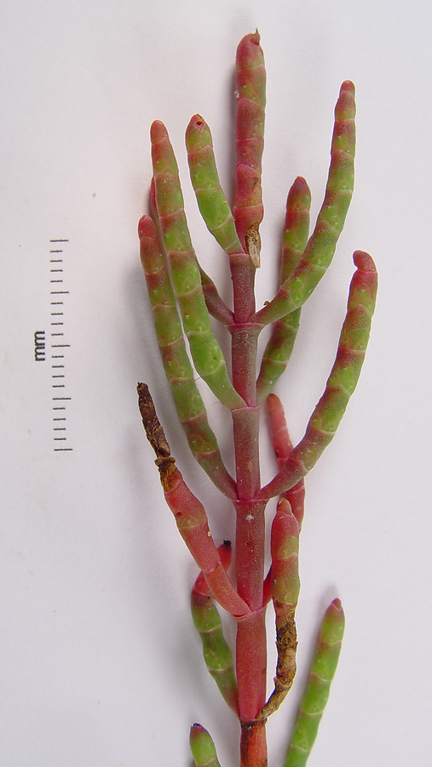
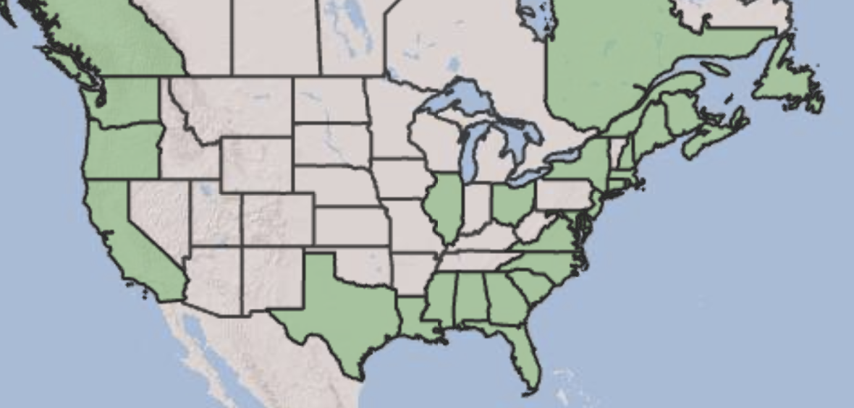
Salicornia depressa (Pickleweed)
An annual salt loving succulent that grows along the East and West coasts of North America
Stores Na⁺ in shoots and roots
Good at absorbing heavy metals - remediation
High marsh founder species
Adapted From: USDA
Credit: Donald Cameron
Notes:
Red Picture: Salicornia depressa (common glasswort): Go Botany
Green Picture: USDA Plants Database Plant Profile General
Salazar et al.

Slide 4
Question
What effect do ammonium and nitrate have on root growth and flower production?
Roots have greatest contact with water, so we expect greatest expressional response
Flowers likely indicate reproductive potential; could show impact on fitness

Slide 5
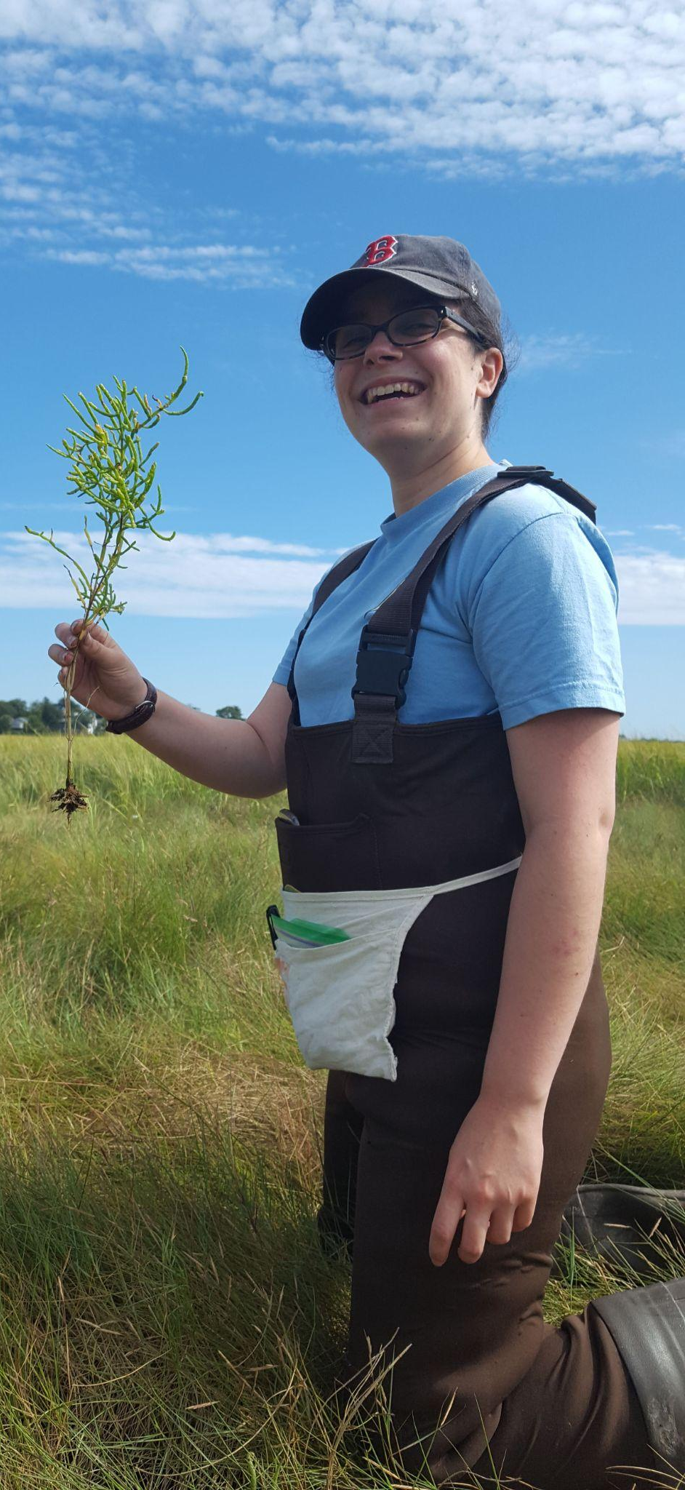

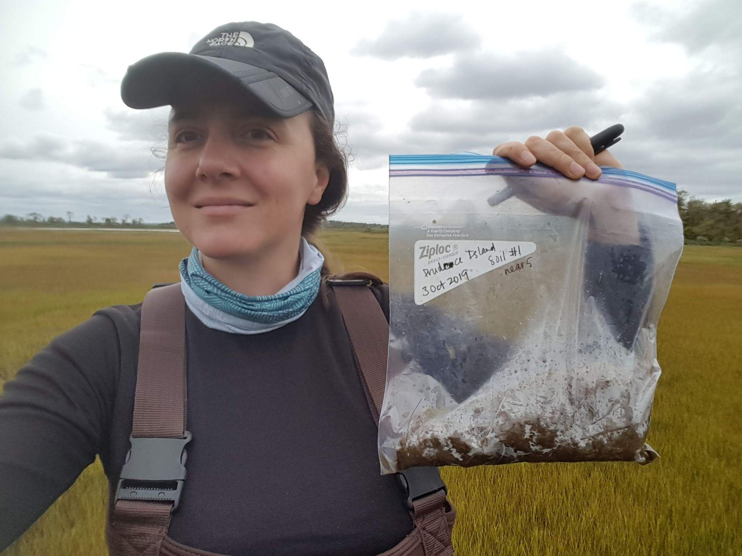
Previous Work
Alice
Dr. Brook
Emily & Scarlet

Slide 6
Hypothesis
Nitrate is a better source of nitrogen for salicornia than ammonium.

Slide 7
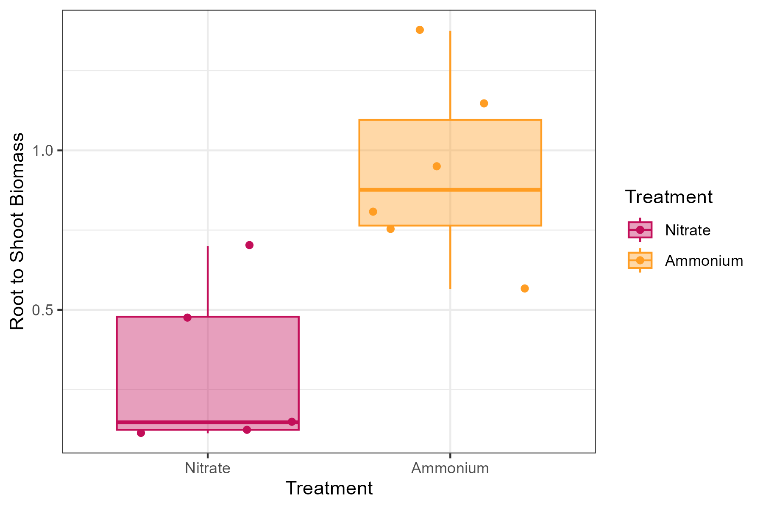
Analysis of Previous Data
t = -3.6874, df = 8.8984, p-value = 0.005116

Slide 8
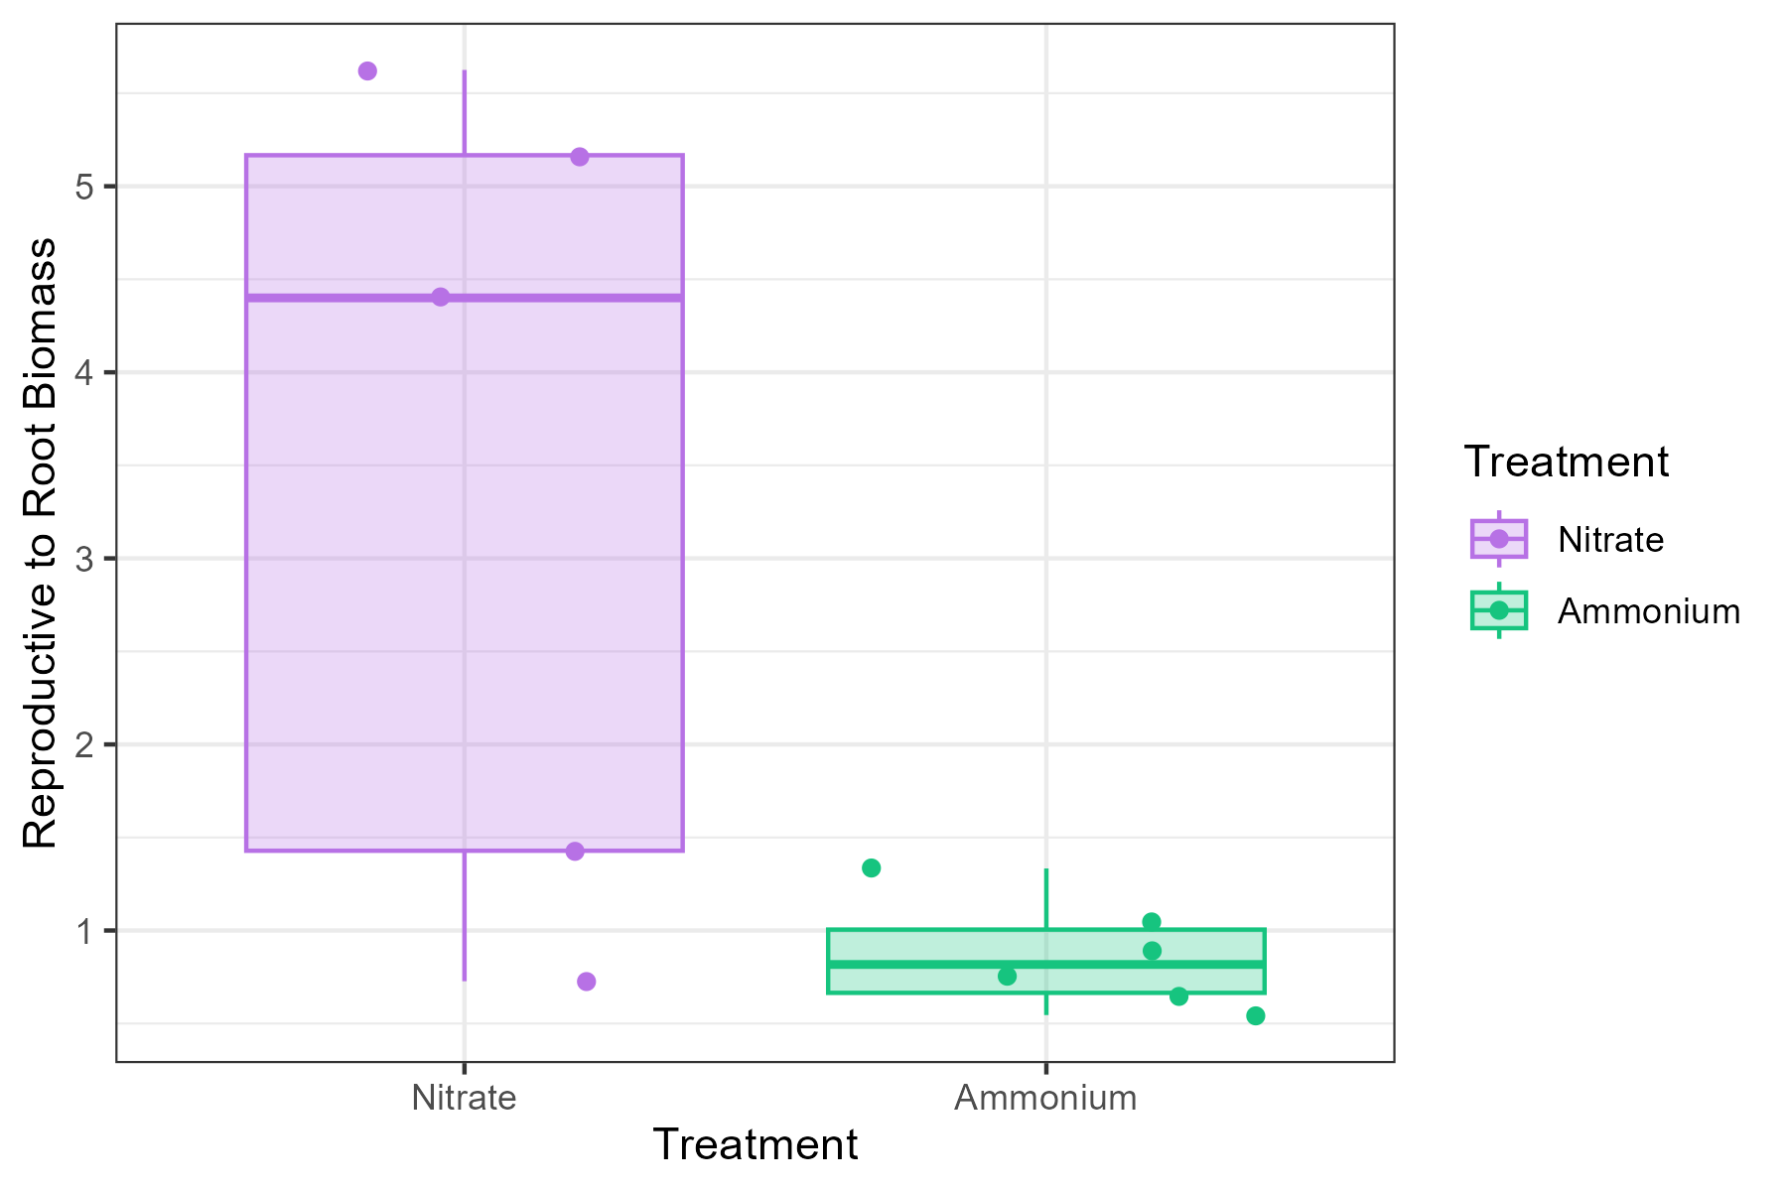
Analysis of Previous Data
t = 2.5807, df = 4.1116, p-value = 0.05964

Slide 9
Pipeline Overview
First from the initial fastq files we trimmed down the RNA sequence, removing sections of bad reads.
Aligned the RNA sequence against the S. depressa genome into .sam file
We then converted these files into binary
Sorted and indexed these binary files
Combined the binary files with an annotated genome file which allowed us to see gene expression in matrix format
This matrix data was then used in R in order to produce the final product of the volcano plot which show the most differentially expressed genes

Slide 10
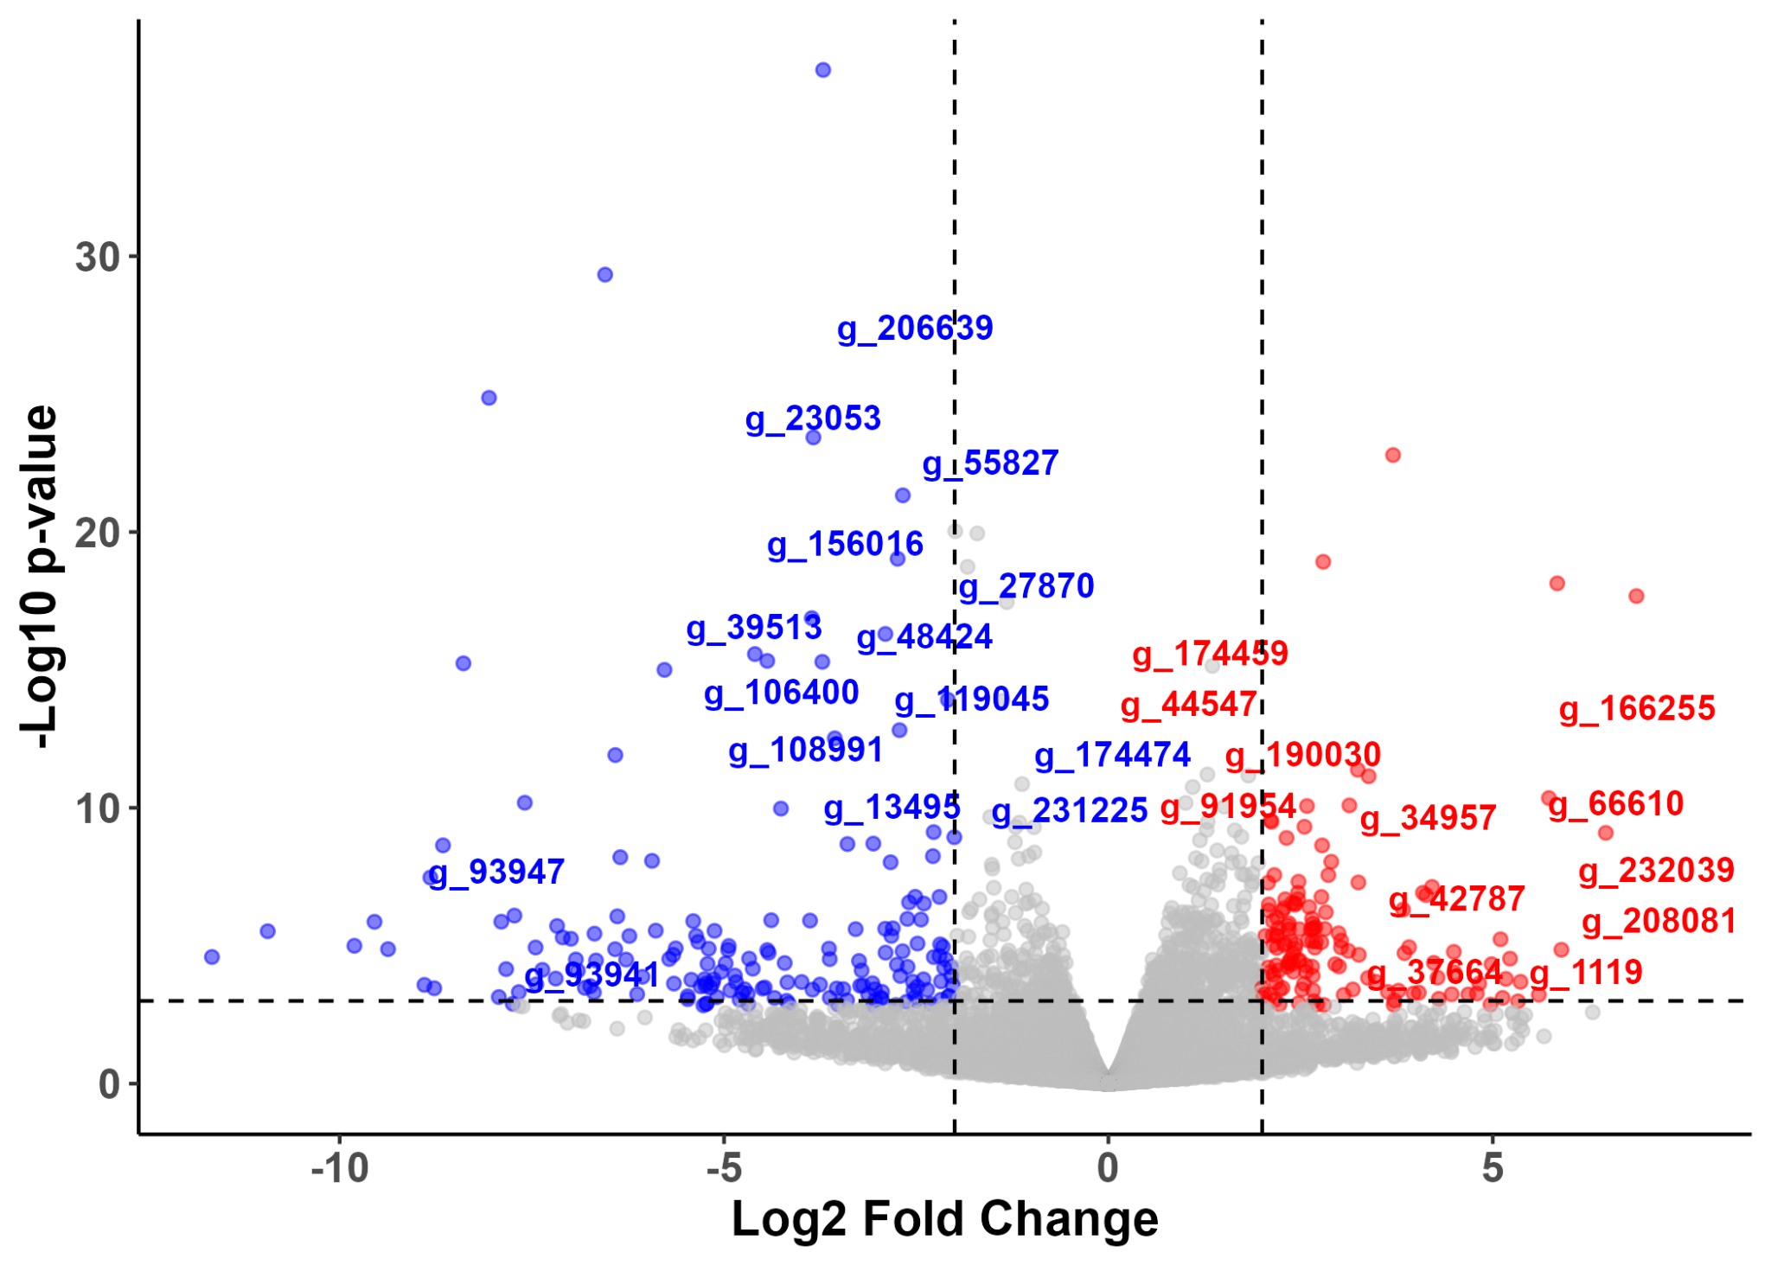
Results - Root Gene Expression
Volcano plot

Slide 11
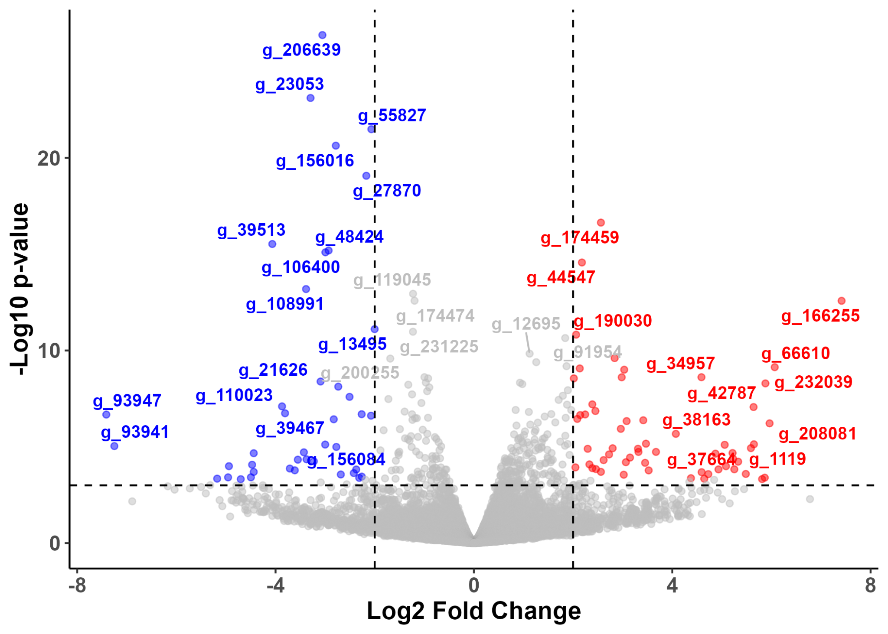
Results - Flower Gene Expression
Volcano plot

Slide 12
Genes of Interest
Gene 1: 206639 nicotinate transport
Downregulated in both root and flower tissue in nitrate treatment group
Related to metabolism through NADH
Upregulated in potato roots (Guo et al., 2022)
In nitrogen deficient conditions, potatoes move nitrogen from roots to stems to leaves
In Salicornia nitrate treatment, plants are not nitrogen deficient, therefore downregulate nitrogen transport
Indicates that nitrate nourishes Salicornia more effectively
Notes:
Gene 1: Transcriptome analysis reveals multiple effects of nitrogen accumulation and metabolism in the roots, shoots, and leaves of potato (Solanum tuberosum L.) | BMC Plant Biology | Full Text
Gene 2: Role of ATP-binding cassette transporters in maintaining plant homeostasis under abiotic and biotic stresses - PubMed

Slide 13
Genes of Interest
Gene 2: 31623 ABC transport protein in chloroplasts
Upregulated in floral tissue
Involved in nutrient uptake, tolerance to abiotic stress, and tolerance to metal toxicity (Dahuja et al., 2021)
Gene 3: 57933 Heat Shock Stress Response Protein
Downregulated in tissue treated with nitrate
A chaperone protein (Janowska et al, 2019)
Delays protein aggregation
Notes:
Gene 2: Role of ATP-binding cassette transporters in maintaining plant homeostasis under abiotic and biotic stresses - PubMed
Gene 3: Mechanisms of Small Heat Shock Proteins - PubMed

Slide 14
Genes of Confusion
We found a number of genes associated with viruses such as g_16106, an RNA directed DNA polymerase
Downregulated in nitrate treated group
g_174459 is associated with transposons
Upregulated in ammonium treated group

Slide 15
Further Research
Continue looking into differentially expressed genes and seeing if they have a connection to root or flower growth.
It is unclear what source of nitrogen Salicornia contacts most often. Water in field sites could be tested to hypothesise the effect of eutrophication.

Slide 16
Citations
Mentor: Dr. Brook Moyers
Avinash Sreedasyam, Et al. JGI Plant Gene Atlas: an updateable transcriptome resource to improve functional gene descriptions across the plant kingdom, Nucleic Acids Research, Volume 51, Issue 16, 8 September 2023, Pages 8383–8401, https://doi.org/10.1093/nar/gkad616
Saltmarsh plant responses to eutrophication - Johnson - 2016 - Ecological Applications - Wiley Online Library Johnson, D. S., Warren, R. S., Deegan, L. A., & Mozdzer, T. J. (2016). Saltmarsh plant responses to eutrophication. Ecological Applications, 26(8), 2649–2661. https://doi.org/10.1002/eap.1402
Salazar, O.R., Chen, K., Melino, V.J. et al. SOS1 tonoplast neo-localization and the RGG protein SALTY are important in the extreme salinity tolerance of Salicornia bigelovii. Nat Commun 15, 4279 (2024). https://doi.org/10.1038/s41467-024-48595-5
The UniProt Consortium , UniProt: the Universal Protein Knowledgebase in 2025, Nucleic Acids Research, Volume 53, Issue D1, 6 January 2025, Pages D609–D617, https://doi.org/10.1093/nar/gkae1010
Transcriptome analysis reveals multiple effects of nitrogen accumulation and metabolism in the roots, shoots, and leaves of potato (Solanum tuberosum L.) | BMC Plant Biology | Full Text
Role of ATP-binding cassette transporters in maintaining plant homeostasis under abiotic and biotic stresses - PubMed
Mechanisms of Small Heat Shock Proteins - PubMed

Slide 17
Thank You!
This presentation is a product of the iTCGA: Integrated Training in Computational Genomics and Data Sciences workshop, which is funded by the U54 Comprehensive Partnership for Cancer Disparities Research, NIH/NCI grant # 3U54CA156734-13S2

